Slide 1
Rocks
A
Types of Rocks
B
Igneous Rocks
C
Metamorphic Rocks
D
Sedimentary Rocks
E
Rock Cycle
100
100
100
100
100
200
200
200
200
200
300
300
300
300
300
Jeopardy

Slide 2
Question:
$100
What type of rock is formed from melted magma or lava?

Slide 3
Answer:
$100
Igneous

Slide 4
Question:
$200
What rock is formed from layers and layers of sediments?

Slide 5
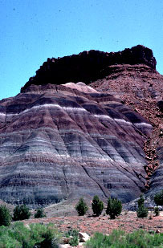
Answer:
Rocks $200
Sedimentary

Slide 6
Question:
$300
What type of rock is formed when the rock changes into another kind of rock?

Slide 7
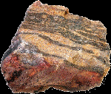
Answer:
$300
Metamorphic

Slide 8
Question:
$100
What is magma called when it is above ground?

Slide 9
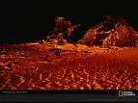
Answer:
$100
Lava

Slide 10
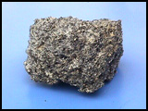
Question:
$200
Pumice is a rock that cooled above ground. Did it cool slowly or quickly?

Slide 11
Answer:
Igneous $200
Slowly

Slide 12
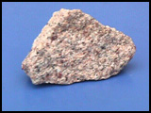
Question:
$300
This type of rock is formed by slowly cooling pockets of lava underneath the earth’s surface.

Slide 13
Answer:
Igneous $300
Granite

Slide 14
Question:
$100
What are Metamorphic rocks?

Slide 15
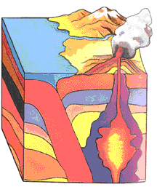
Answer:
$100
Igneous or sedimentary rocks under heat and pressure turn into a metamorphic rock.

Slide 16
Question:
$200
What are some characteristics of metamorphic rocks?

Slide 17
Answer:
$200
Flattened grains, swirls, not as crystal like, layers are mixed together
What

Slide 18
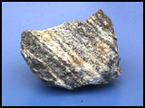
Question:
$300
Gneiss is what type of igneous rock that was changed from heat and pressure?

Slide 19
Answer:
$300
Granite

Slide 20
Question:
$100
What is a Sedimentary Rock?

Slide 21
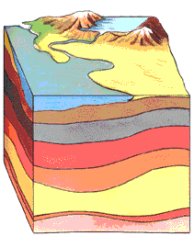
Answer:
$100
A rock made from layers of layers of sediments that turn into rock because of pressure.

Slide 22
Question:
$200
What is erosion of rocks?

Slide 23
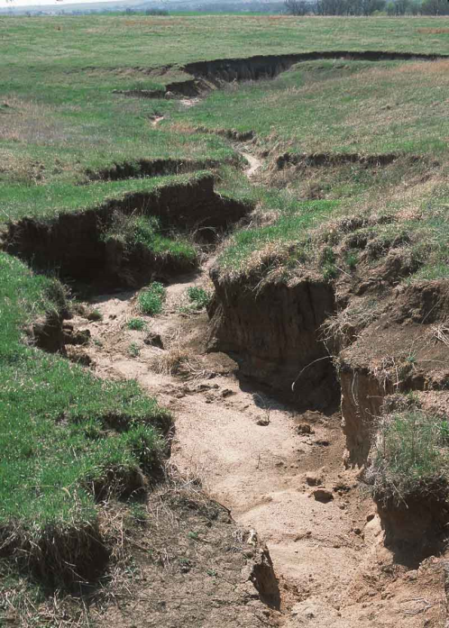
Answer:
$200
When little bits and pieces of rock are broken off and carried away and deposited into lakes, rivers or on top of other layers of soil.

Slide 24
Question:
$300
Why are fossils commonly found in sedimentary rock?

Slide 25
Answer:
$300
Animals need to be buried quickly by sediments in order to become fossils. They need pressure but not heat to become fossils.

Slide 26
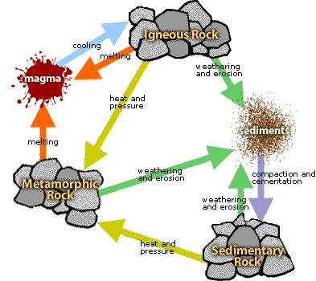
Question:
$100
Weathering and erosion causes all kind of rocks to turn into what?

Slide 27
Answer:
$100
Sediments

Slide 28
Question:
$200
Igneous Rocks and Sedimentary rocks turn into what rock under heat and pressure?

Slide 29
Answer:
$200
Metamorphic Rock

Slide 30
Question:
$300
When igneous and Metamorphic Rocks melt, it turns into what?

Slide 31
Answer:
$300
Magma

